Slide 1


Leptospirosis
www.medilinkint.com
info@medilinkint.com

Slide 2

What is Leptospirosis?
Leptospirosis is an infection caused by a bacteria called “Spirochete” found in the urine of animals like rats and dogs.
Bacteria survive well in wet and warm environments, making remote work sites high-risk.

Slide 3


Why are leptospirosis infections high in remote worksites ?
Standing water, mud, or flooded areas, which can be contaminated
Wet and warm environments
Rodents (primary carriers of Leptospirosis),

Slide 4

Why Should I know more about Leptospirosis?
Leptospirosis is the reason of:
An estimated one million cases globally each year, resulting in almost he effects 60,000 deaths.
Decreases overall worker productivity.
Increased absenteeism and work delays.

Slide 5
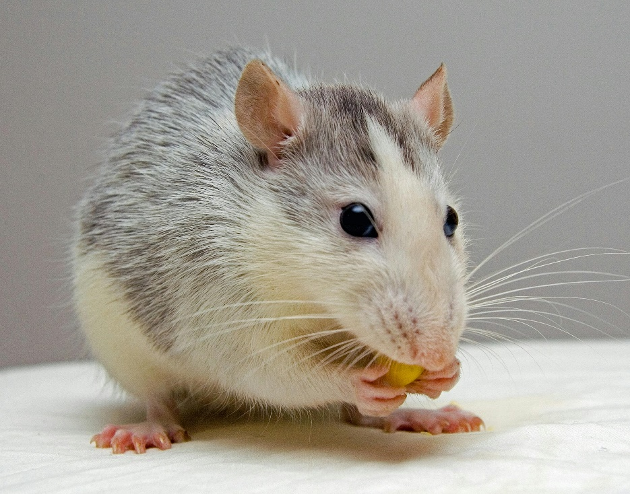
Transmission of Leptospirosis to Human
Direct Transmission (From animals)
Touching urine form rodents, livestock, or other animals around the worksite.
Handling sick or dead animals.
Contact with animals' blood or tissue during work.

Slide 6
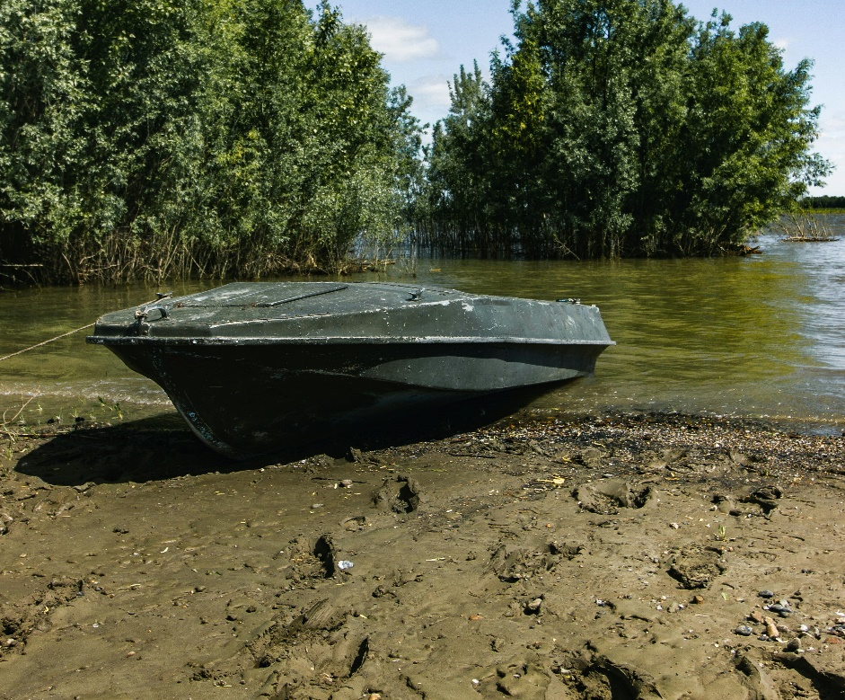
Transmission of Leptospirosis to Human
Indirect Transmission (from environment)
Working in waterlogged areas, mud, or soil contaminated with animal urine.
Using or walking through rivers, ponds, or drainage.
Touching contaminated tools, boots or gloves.

Slide 7
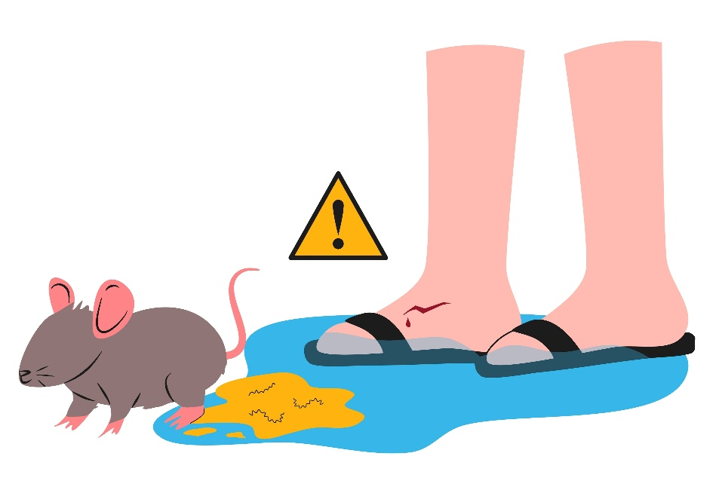
Transmission Cycle
Infected animals (Reservoirs)
Shedd Bacteria in Urine
Bacteria survive for weeks-months in moist, warm conditions
Contaminated environment
Human exposure
Cuts or wound skin
Eyes, nose or mouth
Drinking unsafe water

Slide 8

Transmission Cycle
Human infection
Illness ranges from mild fever to severe disease (kidneys, liver, ling)
No Human-to-human spread
Cycle continues between animas, then, environment and human.

Slide 9

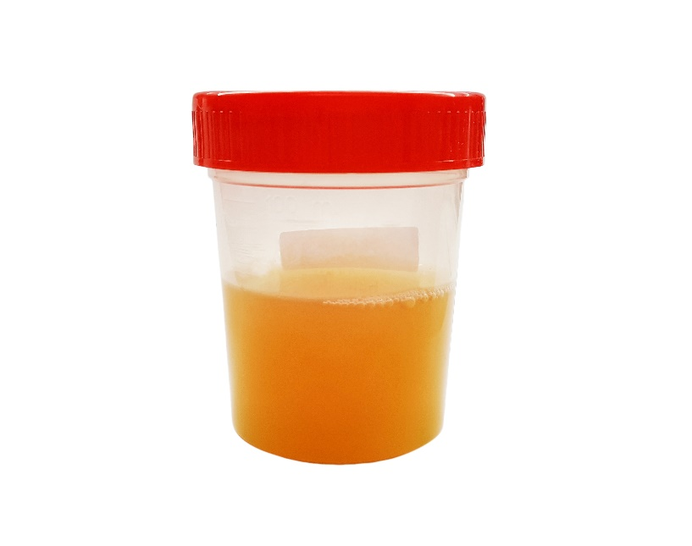
How to know You are suffering from Leptospirosis?
Suffering from Leptospirosis
  Doctor will ask if you worked in water, mud, or near animals recently.
  They will check your body to see if you look sick.
  A blood or urine test can show if you have the germ.

Slide 10

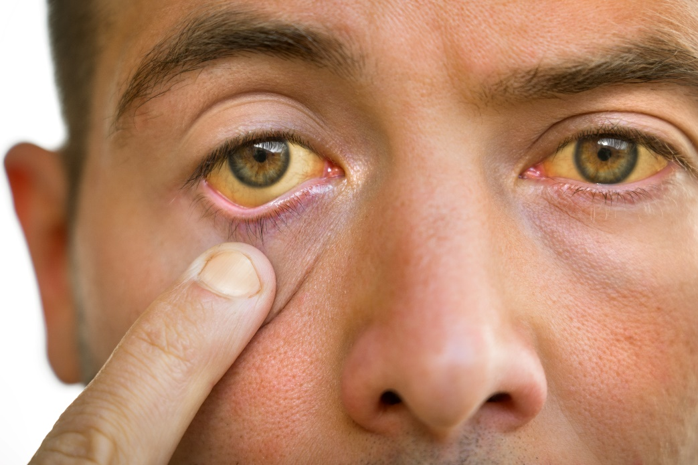
Recognizing Symptoms
Early signs (1–2 weeks after exposure):
Fever,
headache,
muscle pain,
vomiting,
red eyes.
Severe signs:
Yellow eyes,
chest pain,
Difficulty breathing
Unclear thinking

Slide 11


Why It’s Serious?
Untreated leptospirosis can:
Damage liver, kidneys, lungs, and heart.
Cause organ failure or death.

Slide 12


What to do If you feel like you are suffering from Leptospirosis at work?
Tell your supervisor or health officer right away.
Go to the nearest clinic quickly for tests and treatment with antibiotics.
Drink clean water and rest while waiting for care.
Inform the doctor if you worked in water, mud, or with animals.

Slide 13

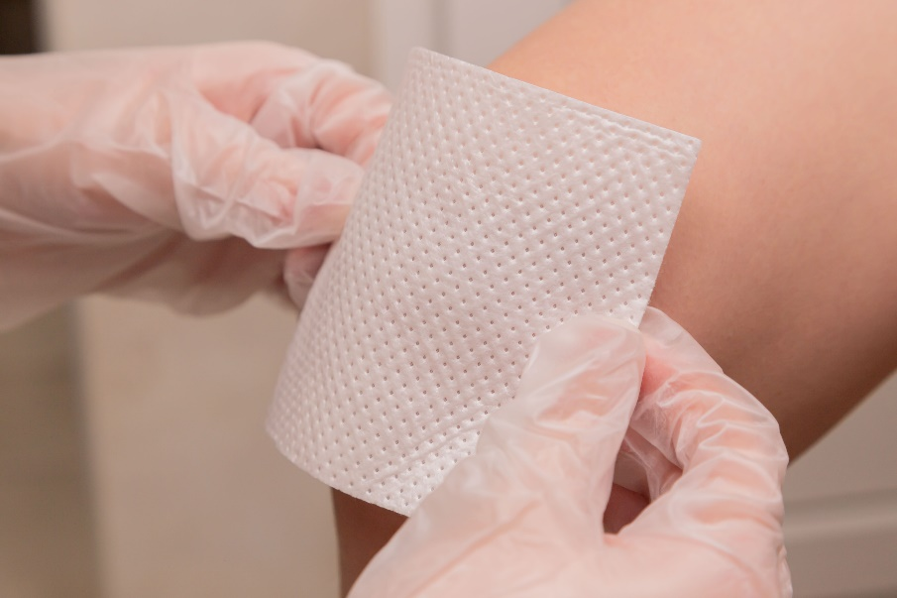
Protect Yourself – Practical Tips
Wear boots and gloves when working in wet/muddy conditions.
Cover skin cuts before work.
Avoid walking in floodwater when possible.
Wash with soap after work.
Drink only boiled or bottled water.
Store food/tools away from rodents or waste bins

Slide 14

As Workers you can help keep the work environment safe by:
Throwing garbage in proper bins and making sure bins are not overflowing.
Keeping garbage areas and storerooms closed to stop rodents from entering.
Storing food safely and keeping it covered.
Staying away from stagnant water and keeping drains clean.
Using toilets, not open areas, for urination/defecation.
Don’t feed or pet street animals near the worksite.

Slide 15
References
1. Gizamba, J. M., & Mugisha, L. (2023). Leptospirosis in humans and selected animals in Sub-Saharan Africa, 2014–2022: A systematic review and meta-analysis. BMC Infectious Diseases, 23, 649. https://doi.org/10.1186/s12879-023-08574-5
2. Ji, Z., Jian, M., Su, X., et al. (2024). Efficacy and safety of antibiotics for treatment of leptospirosis: A systematic review and network meta-analysis. Systematic Reviews, 13, 108. https://doi.org/10.1186/s13643-024-02519-y
3. Sawesi, S., Jadhav, A., & Rashrash, B. (2025). Machine Learning and Deep Learning Techniques for Prediction and Diagnosis of Leptospirosis: Systematic Literature Review. JMIR Medical Informatics, 13, e67859. https://doi.org/10.2196/67859
4. Azevedo, S. S. de. (2023). Epidemiology of Leptospira sp. Infection: Current Status, Insights and Future Prospects. Microorganisms, 12(1), 22. https://doi.org/10.3390/microorganisms12010022
5. Systematic Review of Diagnostic Accuracy (MAT, PCR, IgM-ELISA) (up to 2022) – BMC Infectious Diseases (details from multi-year global assessment).
6. Bradley, E. A., & Lockaby, G. (2023). Leptospirosis and the Environment: A Review and Future Directions. Pathogens, 12, 1167.

